Slide 1
Convolutional Neural Network (CNNs)

Slide 2
What are CNNs?
A Convolutional Neural Network (CNN), also known as ConvNet, is a special type of deep learning algorithm particularly adept at tasks involving images and other grid-like data, like time series.
There are 3 basic components of a CNN
The Convolution Layer
The Pooling Layer
The Fully Connected Layer

Slide 3
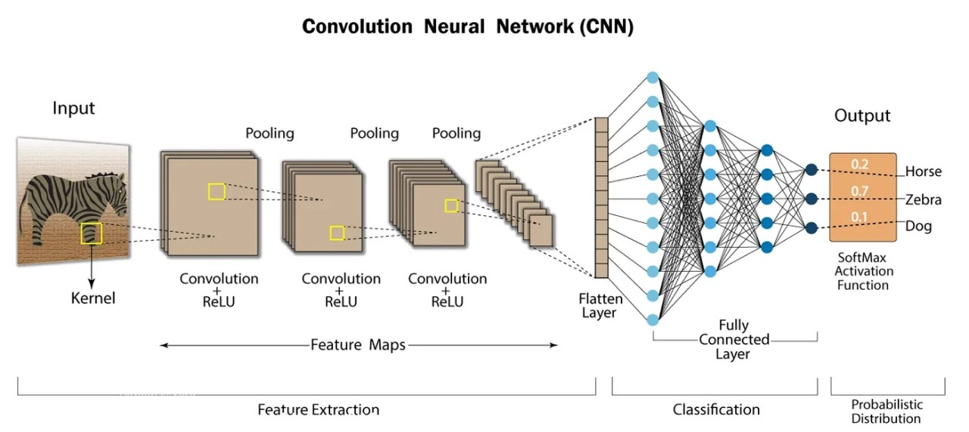
Architecture of CNN

Slide 4
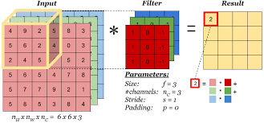
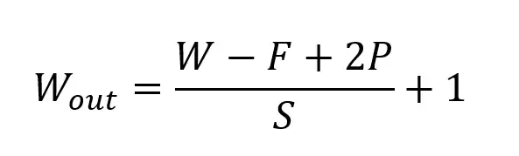
The Convolution Layer
The Convolutional Layer makes use of a set of learnable filters. A filter is used to detect the presence of specific features or patterns present in the original image (input).
This filter is convolved (slided) across the width and height of the input file, and a dot product is computed to give an activation map.
If the padding is zero - the output is smaller than the input

Slide 5
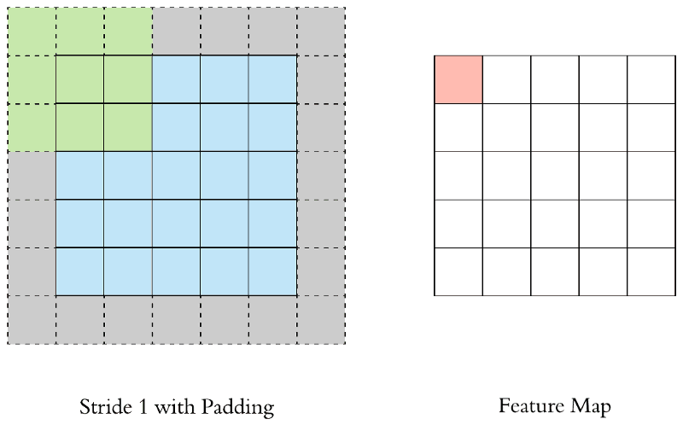
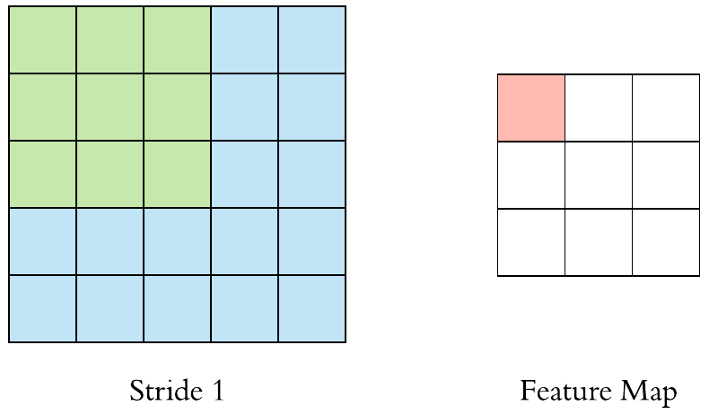
Padding and Stride
Padding
It is a process of adding zeros to the input matrix symmetrically.
To maintain the dimension of output as in input
Stride
Stride denotes how many steps we are moving in each steps in convolution.

Slide 6
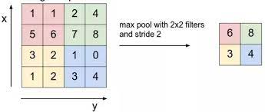
The Pooling Layer
The pooling layer derives summary statistics of the nearby outputs
It helps in reducing the amount of parameters and computation in the network
Average Pooling - reports average of the rectangular neighborhood
L2 norm pooling - returns L2 norm of the rectangular neighborhood
Max pooling - reports the maximum output from the neighborhood.

Slide 7
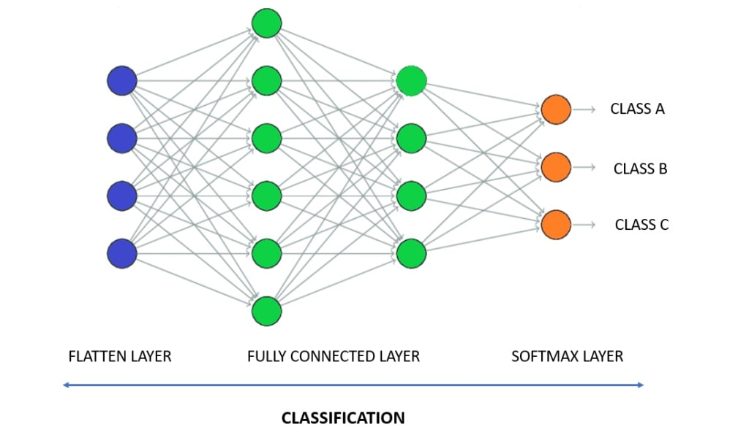
The Fully Connected Layer
The convolution and pooling layers only extract features and reduce the number of parameters from the original images. However, to generate the final output we need to apply a fully connected layer to generate an output equal to the number of classes we need.

Slide 8
Types of CNN
Based on the problems, we have different CNN architectures which are used in computer vision
The five major computer vision techniques which can be addressed using CNNs are
Image Classification
Object Detection
Object Tracking
Semantic Segmentation
Instance Segmentation
Here we will see SOTA algorithm for Object Detection and Semantic Segmentation

Slide 9
Object Detection
Object detection is a branch of computer vision that aims to locate and identify instances of objects within images and videos.
The different types of detectors are
One-Stage Detector - The entire detection task, including object localization and classification, is done in a single pass through the network. Example - YOLO, SSD, RetinaNet
Two-Stage Detector - The detection is a two-stage process. First stage consists of generation of a set of potential object location and the second stage is used to refine the proposals and make predictions. Example - R-CNN, Fast R-CNN, Faster R-CNN

Slide 10
YOLO (You Only Look Once)
Introduction
You Only Look Once (YOLO): The name accurately captures the essence of the algorithm – it processes an image just once to achieve both object localization and classification.
Unified Framework: Unlike two-stage detectors, YOLO combines region proposal and classification into a single step, making it significantly faster.
Predicts Bounding Boxes and Probabilities: In one pass, YOLO predicts bounding boxes around objects and assigns confidence scores for each detected class.
Real-time Efficiency: YOLO boasts impressive speed, making it ideal for applications like self-driving cars, video surveillance, and augmented reality.

Slide 11
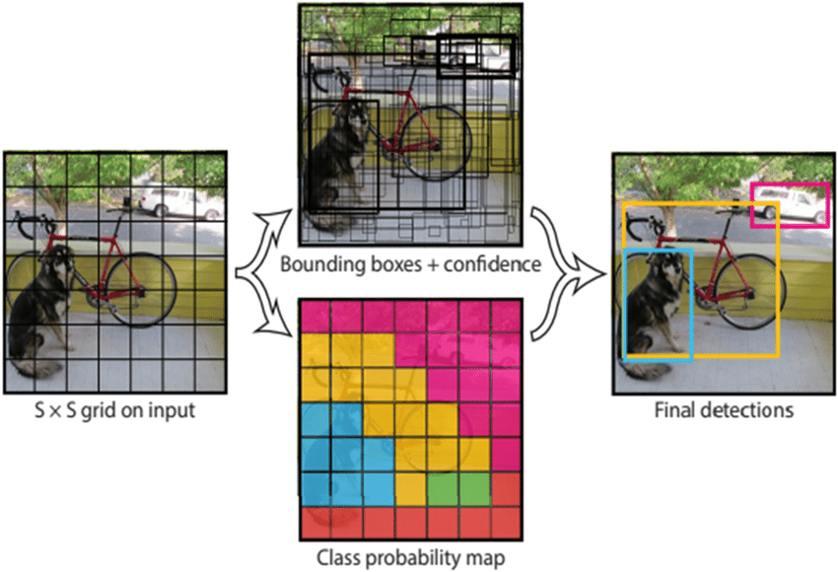
YOLO (You Only Look Once)
How YOLO works?
Dividing the Image into Grids: YOLO first divides the input image into a grid of equal cells.
Predicting per Grid Cell: Each grid cell predicts a bounding box around an object, if present, along with its class probabilities.
Confidence Level: YOLO assigns a confidence score to each prediction, indicating the certainty of its detection and classification.
Non-Maximal Suppression: To avoid duplicate detections, YOLO employs a non-maximal suppression technique to select the most confident predictions.

Slide 12
YOLO (You Only Look Once)
Advantages and Disadvantages
Advantages
Real-time detection: YOLO's single-stage architecture eliminates the need for separate proposal and classification steps, making it significantly faster than two-stage detectors.
Architecture: YOLO's streamlined architecture requires less computational power compared to other algorithms.
Simple and Elegant: YOLO's single-pass approach is easier to understand and implement compared to the more complex two-stage architecture.
Disadvantages
Accuracy Trade-off: While YOLO’s accuracy sometimes lags behind the best two-stage detectors. This trade-off might not be acceptable for tasks demanding the highest possible precision.
Small Object Detection: Detecting small objects can be tricky for YOLO, especially compared to algorithms specifically designed for such situations.

Slide 13
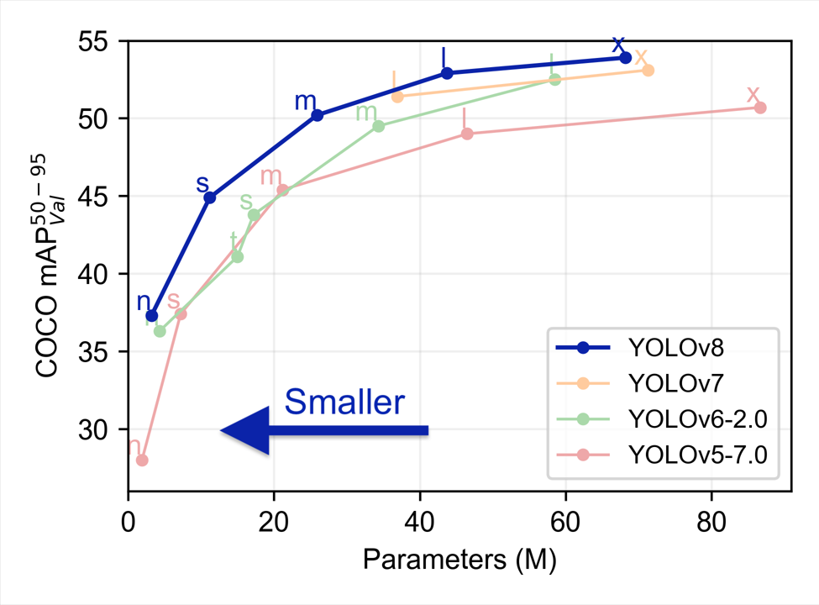
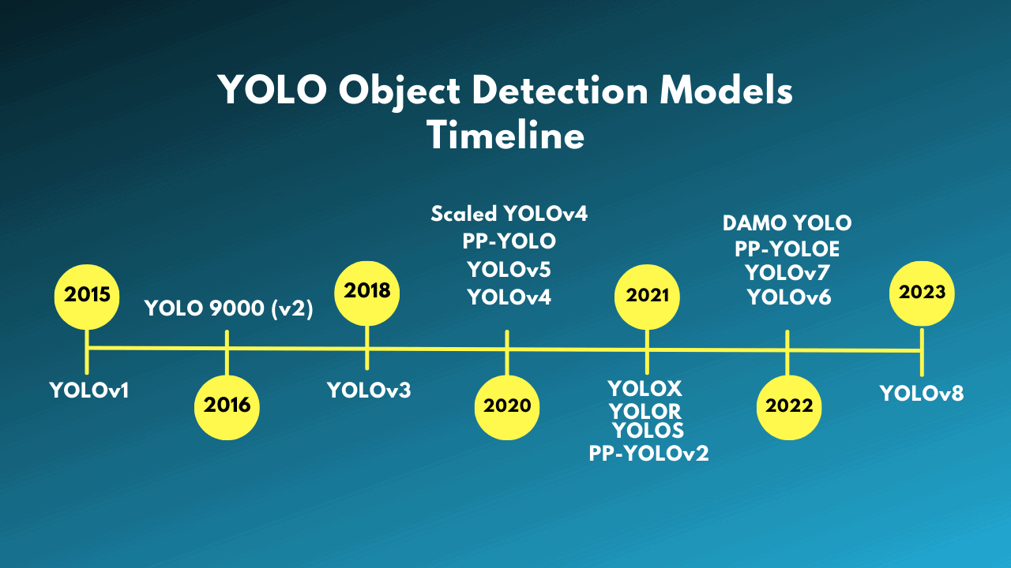
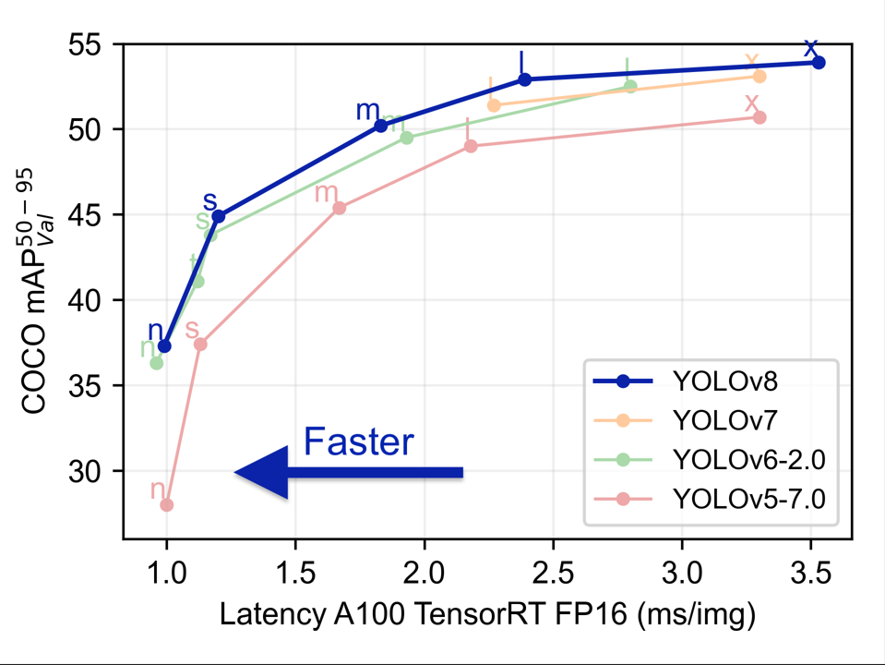
YOLO (You Only Look Once)
Evolution

Slide 14
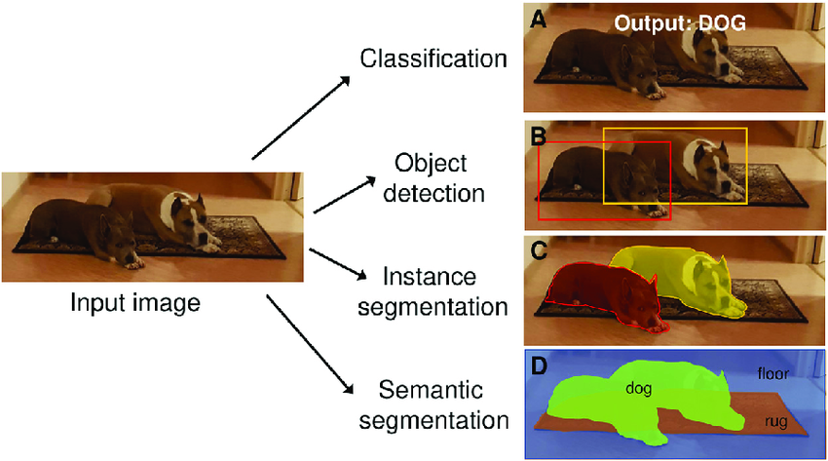
Object Detection vs Image Segmentation

Slide 15
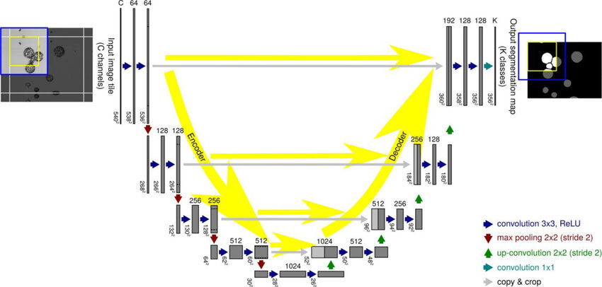
U-Net

Slide 16
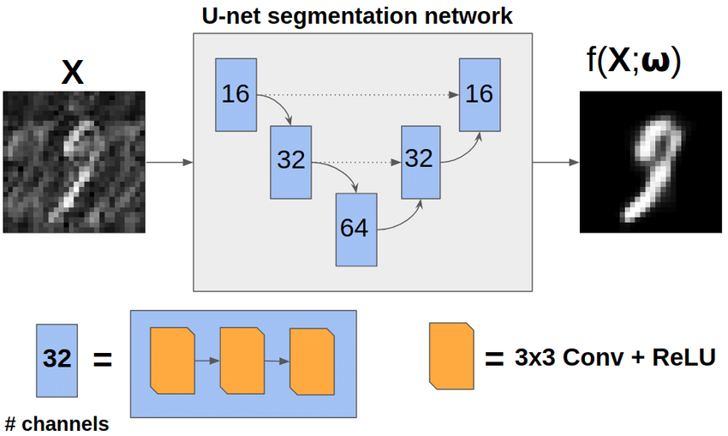
U-Net
Introduction
Pixel-Wise Classification: U-Net tackles the challenge of image segmentation by assigning a specific class label to each individual pixel within the image.
Beyond Binary Boundaries: Unlike simpler approaches, U-Net can handle complex scenes with multiple objects and intricate details
Medical Image Analysis: U-Net excels in analyzing medical images, such as MRIs and CT scans, by accurately segmenting organs, tumors, and other structures, aiding in diagnosis and treatment planning.

Slide 17
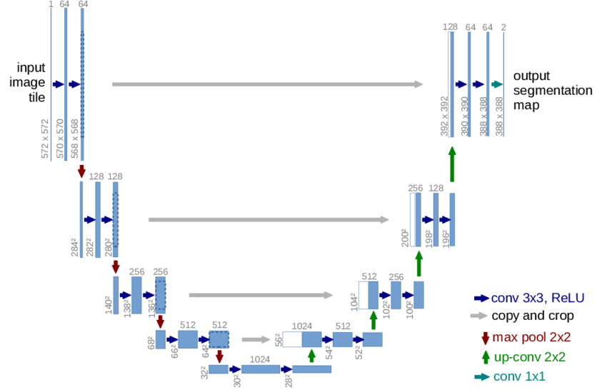
U-Net Architecture

Slide 18
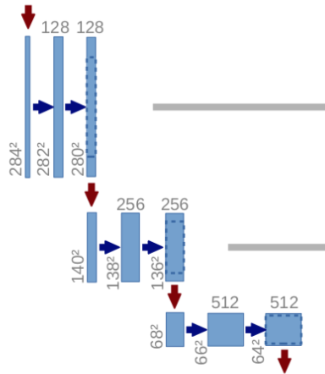
U-Net Architecture
Contracting Path
The journey begins with the contracting path, where the image is downsampled through consecutive convolutional layers. This process extracts high-level features and reduces computational complexity.

Slide 19
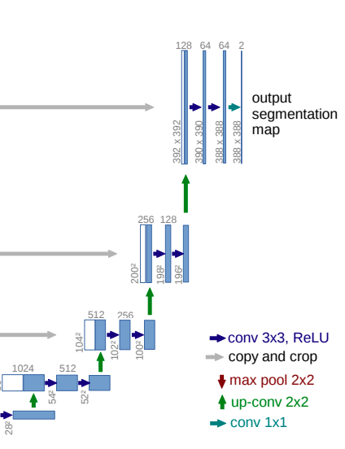
U-Net Architecture
Expanding Path
Next, we embark on the expanding path, where the image resolution is upsampled while incorporating rich contextual information from the contracting path. This stage refines the segmentation masks and captures fine-grained details.

Slide 20
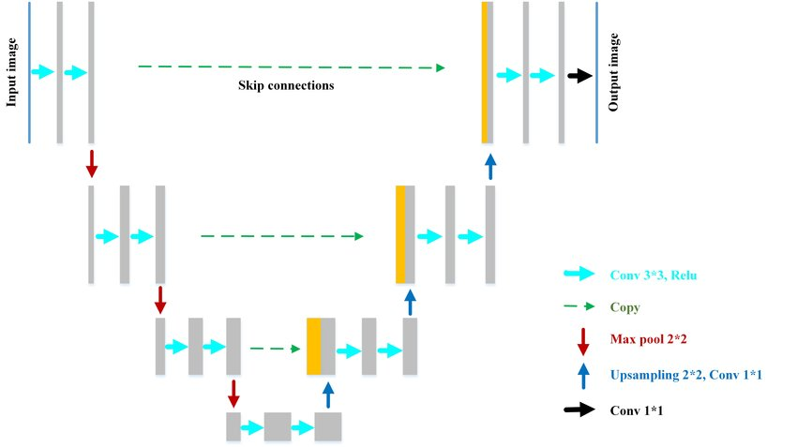
U-Net Architecture
Skip Connections
The magic lies in the skip connections that bridge the contracting and expanding paths. These connections directly transfer crucial spatial information from the contracting path to the expanding path, ensuring precise localization and detailed segmentation results.

Slide 21
U-Net
Advantages and Disadvantages
Advantages
Accuracy with Efficiency: U-Net deep learning architecture captures complex features while maintaining computational feasibility, making it suitable for diverse applications.
Versatility Across Domains: U-Net is not confined to medical images. It thrives in various domains, including satellite imagery analysis, autonomous vehicle segmentation, and even artistic style transfer.
Open-Source and Adaptable: U-Net's open-source nature and modular architecture allow for easy customization and adaptation to specific requirements.
Disadvantages
Limited to Pixel-Level Classification: While accurate, U-Net primarily focuses on pixel-level classification and may not capture deeper semantic relationships within the image.
Potential Overfitting with Small Datasets: U-Net's effectiveness relies on sufficient training data. With limited data, it might be prone to overfitting and not generalize well to unseen images

Slide 22


